Slide 1
A few extra ggplot2 tricks
ggplot2 “extensions”

Slide 2
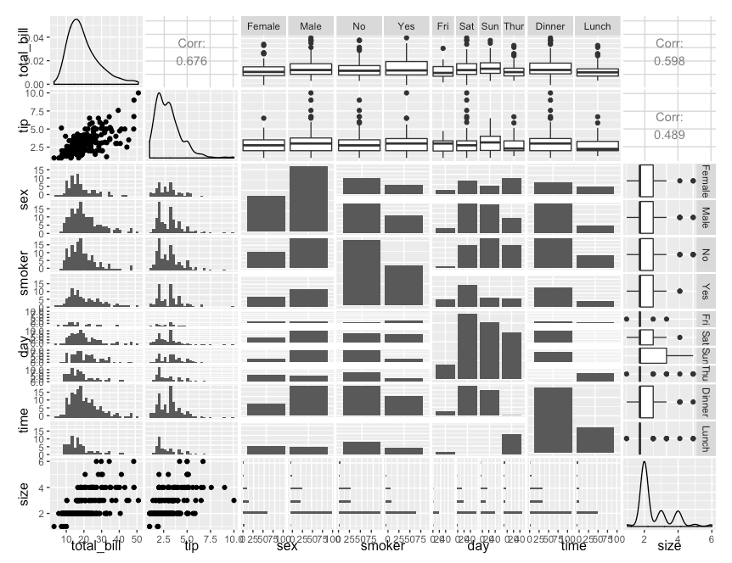
GGally
ggpairs(tips)
http://www.sthda.com/english/wiki/ggally-r-package-extension-to-ggplot2-for-correlation-matrix-and-survival-plots-r-software-and-data-visualization

Slide 3
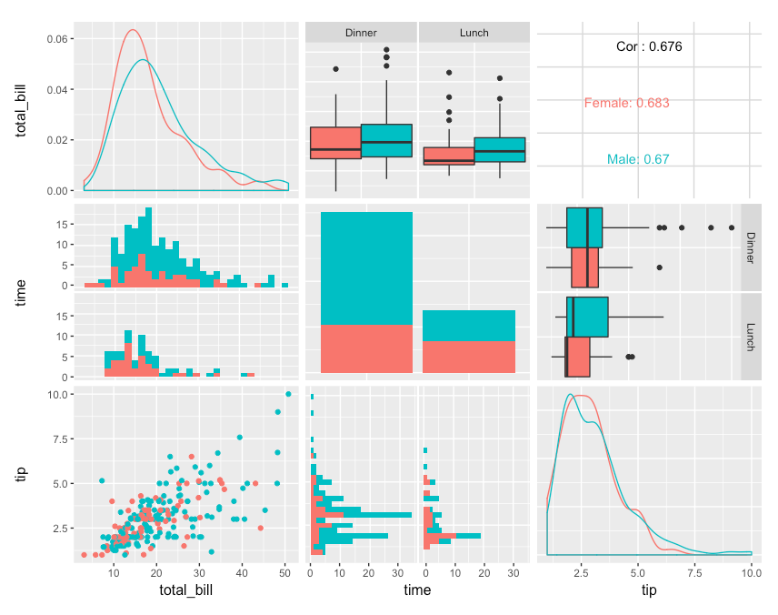
GGally
ggpairs(tips, mapping = aes(color = sex), columns = c("total_bill", "time", "tip"))
https://www.r-bloggers.com/plot-matrix-with-the-r-package-ggally/

Slide 4
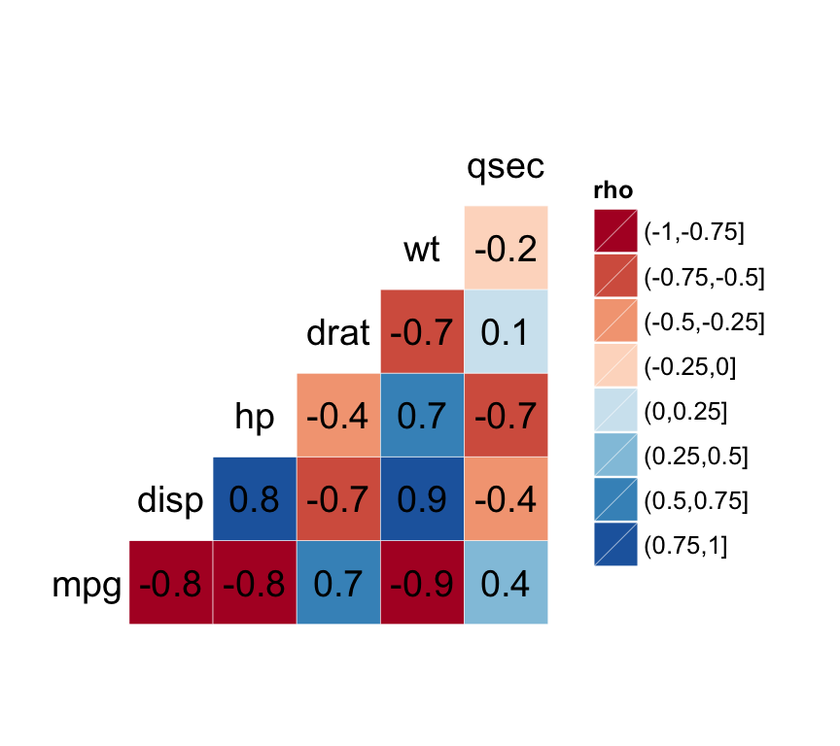
GGally
df <- mtcars[, c(1,3,4,5,6,7)]
ggcorr(df, palette = "RdBu", label = TRUE)
http://www.sthda.com/english/wiki/ggally-r-package-extension-to-ggplot2-for-correlation-matrix-and-survival-plots-r-software-and-data-visualization

Slide 5
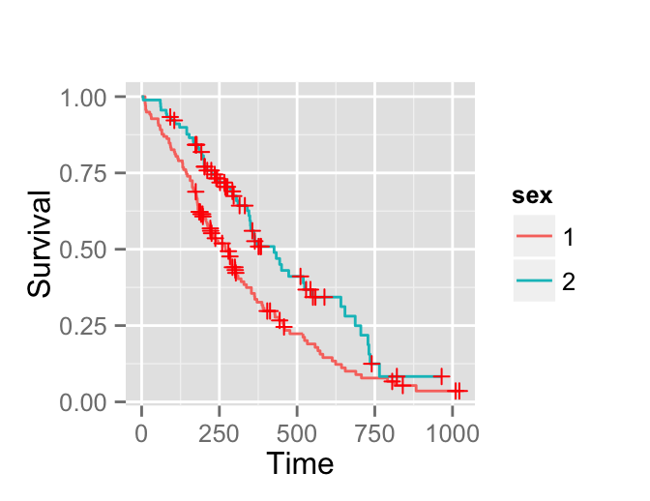
GGally
library(survival) surv <- survfit(Surv(time, status) ~ sex, data = lung)
ggsurv(surv)
http://www.sthda.com/english/wiki/ggally-r-package-extension-to-ggplot2-for-correlation-matrix-and-survival-plots-r-software-and-data-visualization

Slide 6
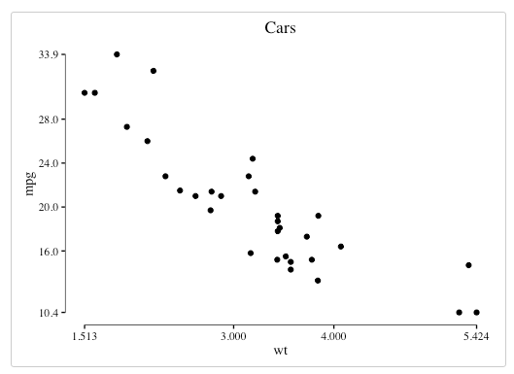
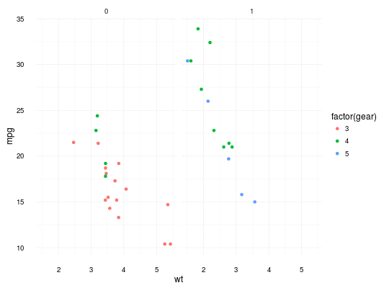
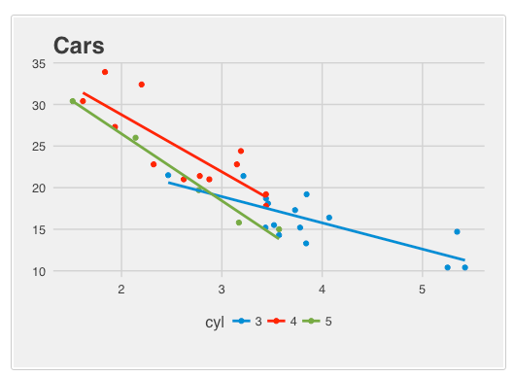
ggthemes
…+theme_tufte()
(below, from base ggplot2)
…+theme_minimal()
…+theme_fivethirtyeight()
https://www.ggplot2-exts.org/ggthemes.html

Slide 7
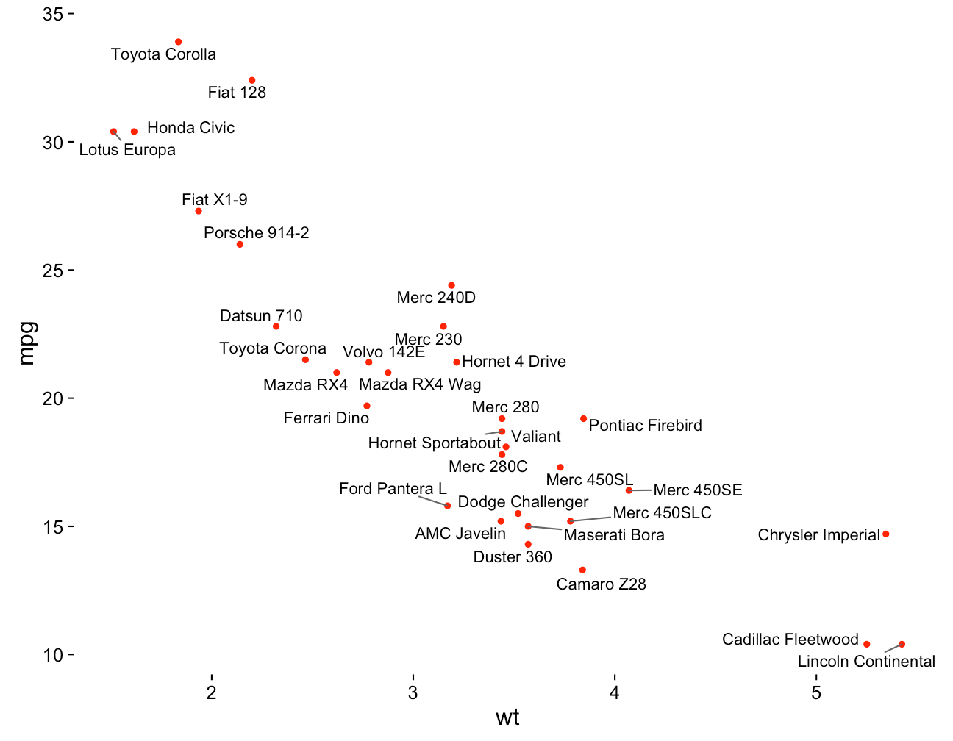
ggrepel
library(ggplot2)
library(ggrepel)
ggplot(mtcars, aes(wt, mpg)) + geom_point(color = 'red') + geom_text_repel(aes(label = rownames(mtcars))) + theme_classic(base_size = 16)
https://www.ggplot2-exts.org/ggrepel.html

Slide 8
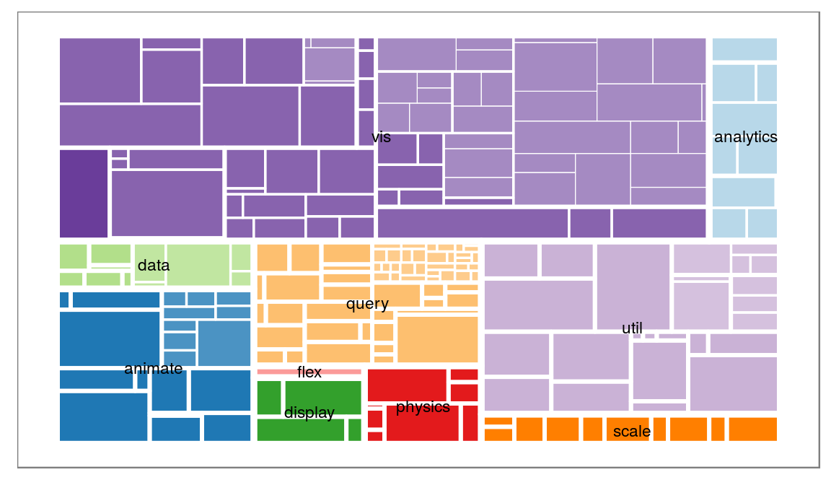
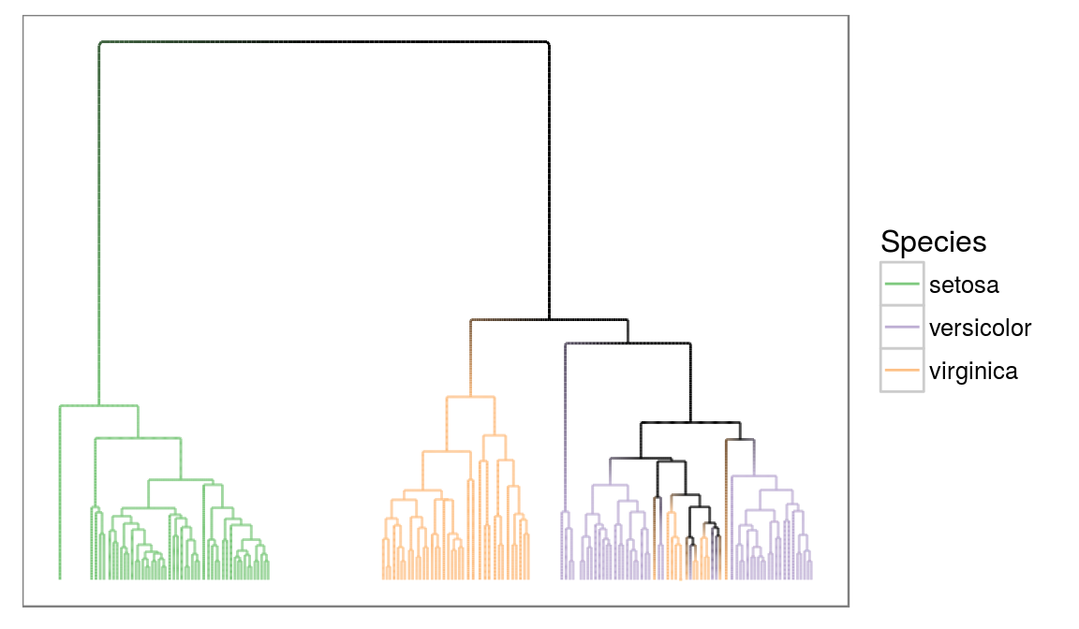
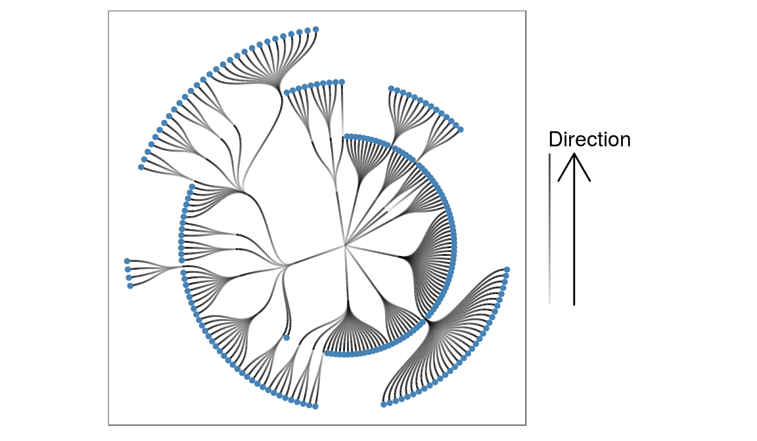
ggraph
geom_treemap
dendrogram
flareGraph
flareGraph

Slide 9
gganimate
p <- ggplot(gapminder, aes(gdpPercap, lifeExp, size = pop, color = continent, frame = year)) +
geom_point() + scale_x_log10()
gg_animate(p)

Slide 10
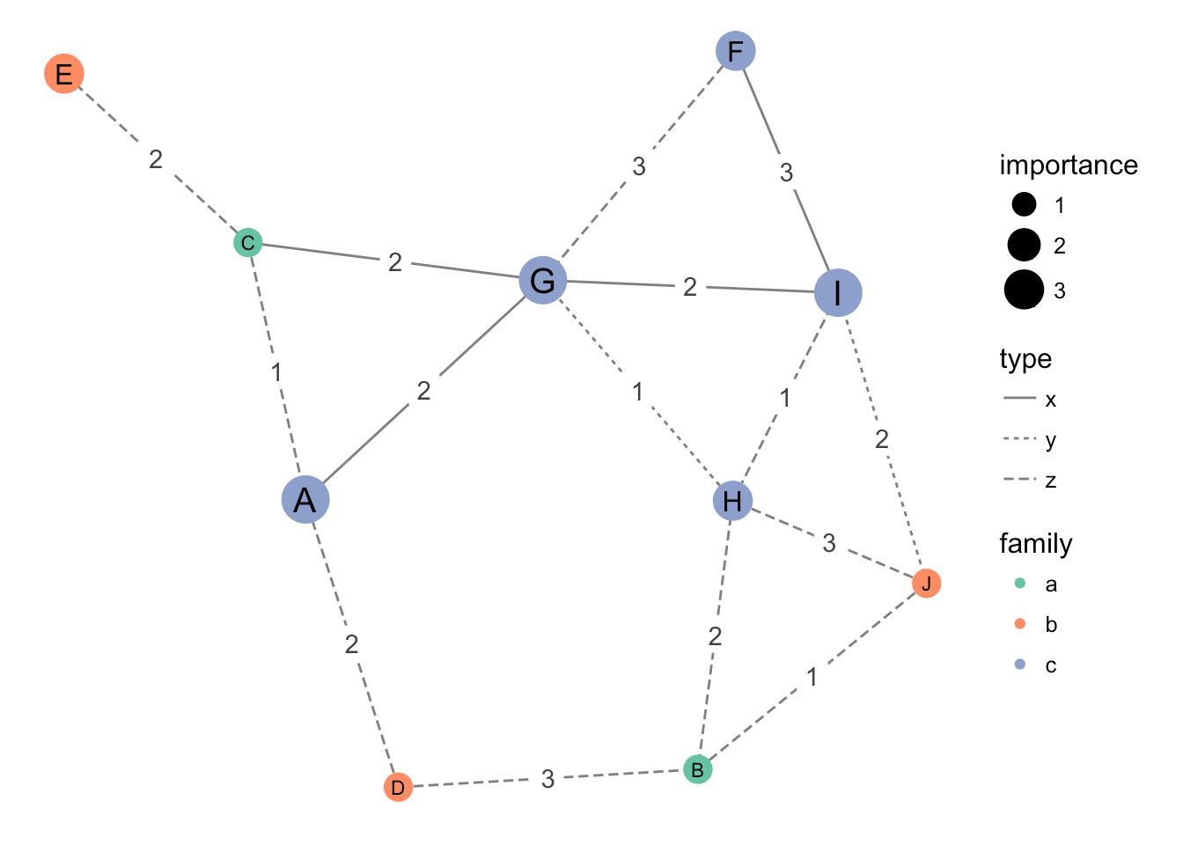
ggnetwork
ggplot(n, aes(x = x, y = y, xend = xend, yend = yend)) +
geom_edges(aes(linetype = type), color = "grey50") +
geom_nodes(aes(x, y, color = family, size = 1.5 * importance)) +
geom_nodetext(aes(label = LETTERS[ vertex.names ], size = 0.5 * importance)) +
geom_edgetext(aes(label = day), color = "grey25") +
scale_color_brewer(palette = "Set2") +
scale_size_area("importance", breaks = 1:3, max_size = 9) + theme_blank()

Slide 11
Other ggplot2 friendly packages…
ggmcmc: Markov Chain Monte Carlo simulation viz
plotROC: plot ROC curves
ggmap: map themes, integration w/ google/OSM
plot.ly*: for interactive ggplots on the web
*not an extension per se, but very cool
https://www.ggplot2-exts.org/ggthemes.html

Slide 12
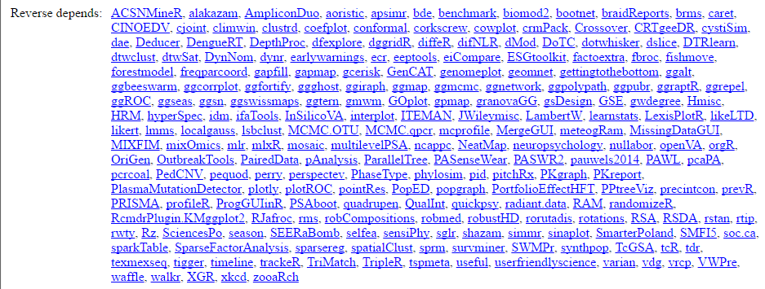
Soooo many…
https://cran.r-project.org/web/packages/ggplot2/index.html

Slide 13
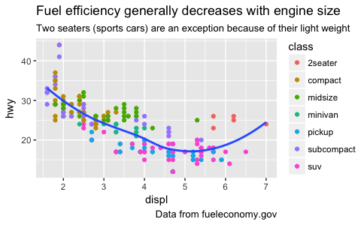
Running “beta”
# install.packages("devtools")
devtools::install_github("hadley/ggplot2")
I’ve used this to catch some early features, like captions and subtitles… though now they’re standard.
Update of ggplot2 coming soon: https://blog.rstudio.org/2016/09/30/ggplot2-2-2-0-coming-soon/
Suggestion: follow the Rstudio blog. Know about the tidyverse.

